Slide 1
Beyond basics –L5
Assembly Language Programming
Dr Emmanuel Ahene

Slide 2
Course Outlook…
Done so far --- Basic Concepts, Beyond basics L2, L3, L4
Looking up to L5, L6, L7 & L8
Addressing modes
Assembly Variables & Constants
Arithmetic instructions
Logical Instructions
Assembly Conditions
Procedures
Recursions
Macros
File management
Memory Management

Slide 3
ADDRESSING MODES

Slide 4
Addressing Modes
Most assembly language instructions require operands to be processed.
An operand address provides the location where the data to be processed is stored.
Some instructions do not require an operand, whereas some other instructions may require one, two or three operands.

Slide 5
Addressing Modes
When an instruction requires two operands, the first operand is generally the destination, which contains data in a register or memory location and the second operand is the source.
Source contains either the data to be delivered (immediate addressing) or the address (in register or memory) of the data.
Generally the source data remains unaltered after the operation.

Slide 6
Addressing Modes
The three basic modes of addressing are:
Register addressing
Immediate addressing
Memory addressing

Slide 7
Basic Computer Organization
Since the 1940's, computers have 3 classic components:
Processor, called also the CPU (Central Processing Unit)
Memory and Storage Devices
I/O Devices
Interconnected with one or more buses
Bus consists of
Data Bus
Address Bus
Control Bus
data bus
registers
Processor
(CPU)
Memory
I/O
I/O
Device
Device
#1
#2
ALU
CU
clock
control bus
address bus

Slide 8
data bus
registers
Processor
(CPU)
I/O
I/O
Memory
Device
Device
#1
#2
ALU
CU
clock
control bus
address bus

Slide 9
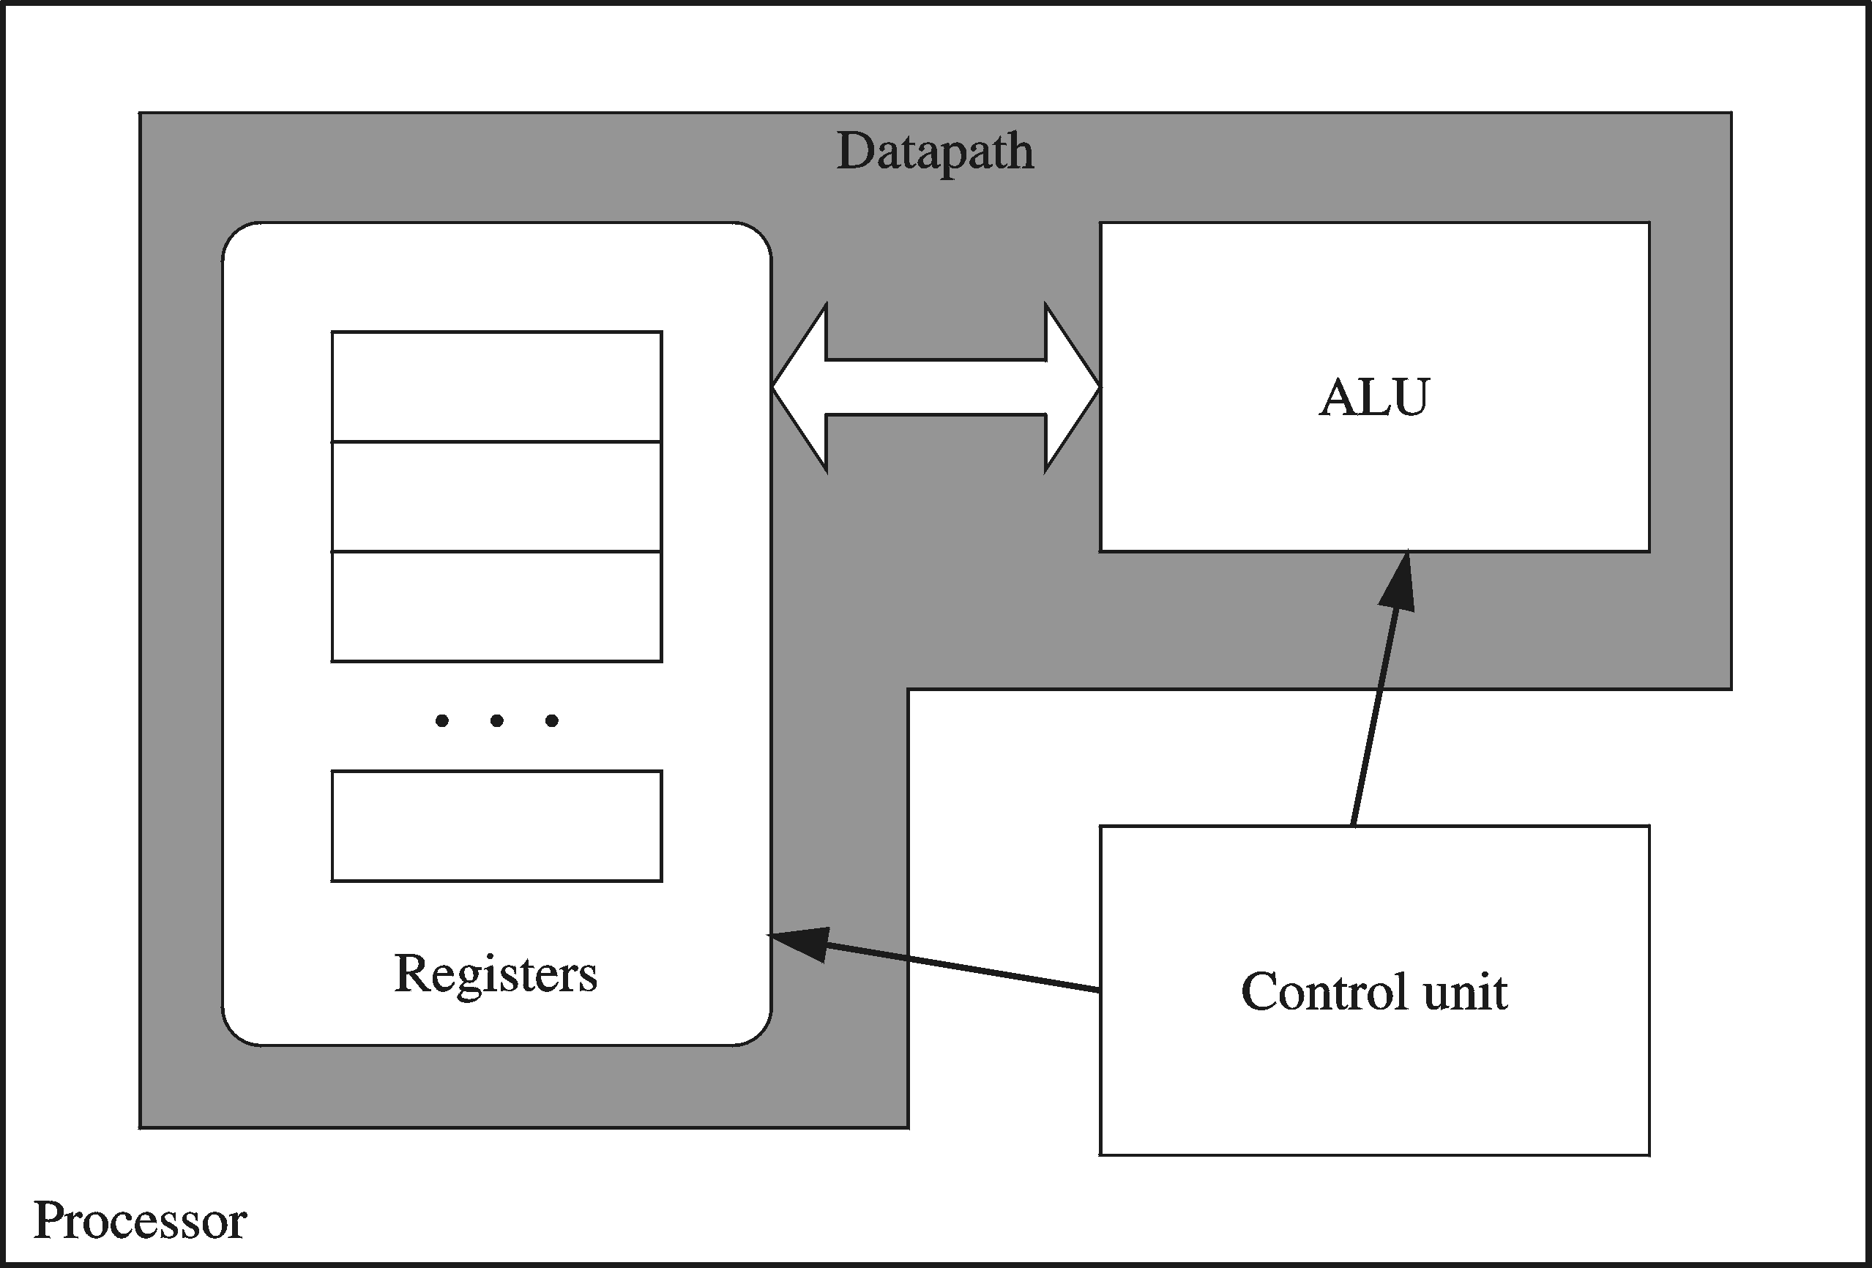
Processor
Processor consists of
Datapath
ALU
Registers
Control unit
ALU
Performs arithmetic
and logic instructions
Control unit (CU)
Generates the control signals required to execute instructions
Implementation varies from one processor to another

Slide 10
Clock
Synchronizes Processor and Bus operations
Clock cycle = Clock period = 1 / Clock rate
Clock rate = Clock frequency = Cycles per second
1 Hz = 1 cycle/sec 1 KHz = 10³ cycles/sec
1 MHz = 10⁶ cycles/sec 1 GHz = 10⁹ cycles/sec
2 GHz clock has a cycle time = 1/(2×10⁹) = 0.5 nanosecond (ns)
Clock cycles measure the execution of instructions
Cycle 1
Cycle 2
Cycle 3

Slide 11
Memory
Ordered sequence of bytes
The sequence number is called the memory address
Byte addressable memory
Each byte has a unique address
Supported by almost all processors
Physical address space
Determined by the address bus width
Pentium has a 32-bit address bus
Physical address space = 4GB = 2³² bytes
Itanium with a 64-bit address bus can support
Up to 2⁶⁴ bytes of physical address space

Slide 12
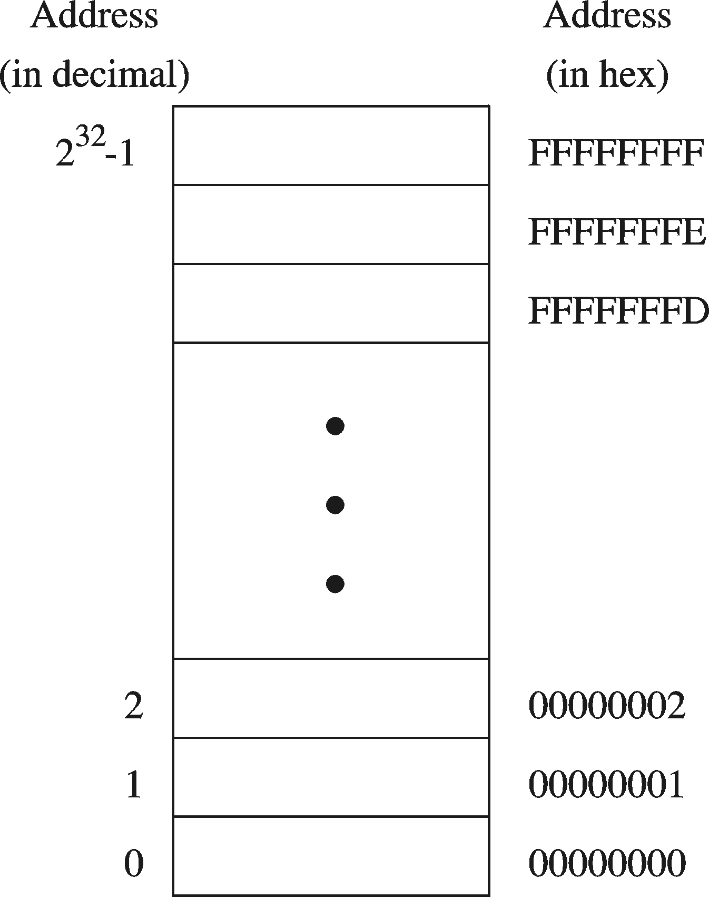
Address Space
Address Space is the set of memory locations (bytes) that can be addressed

Slide 13
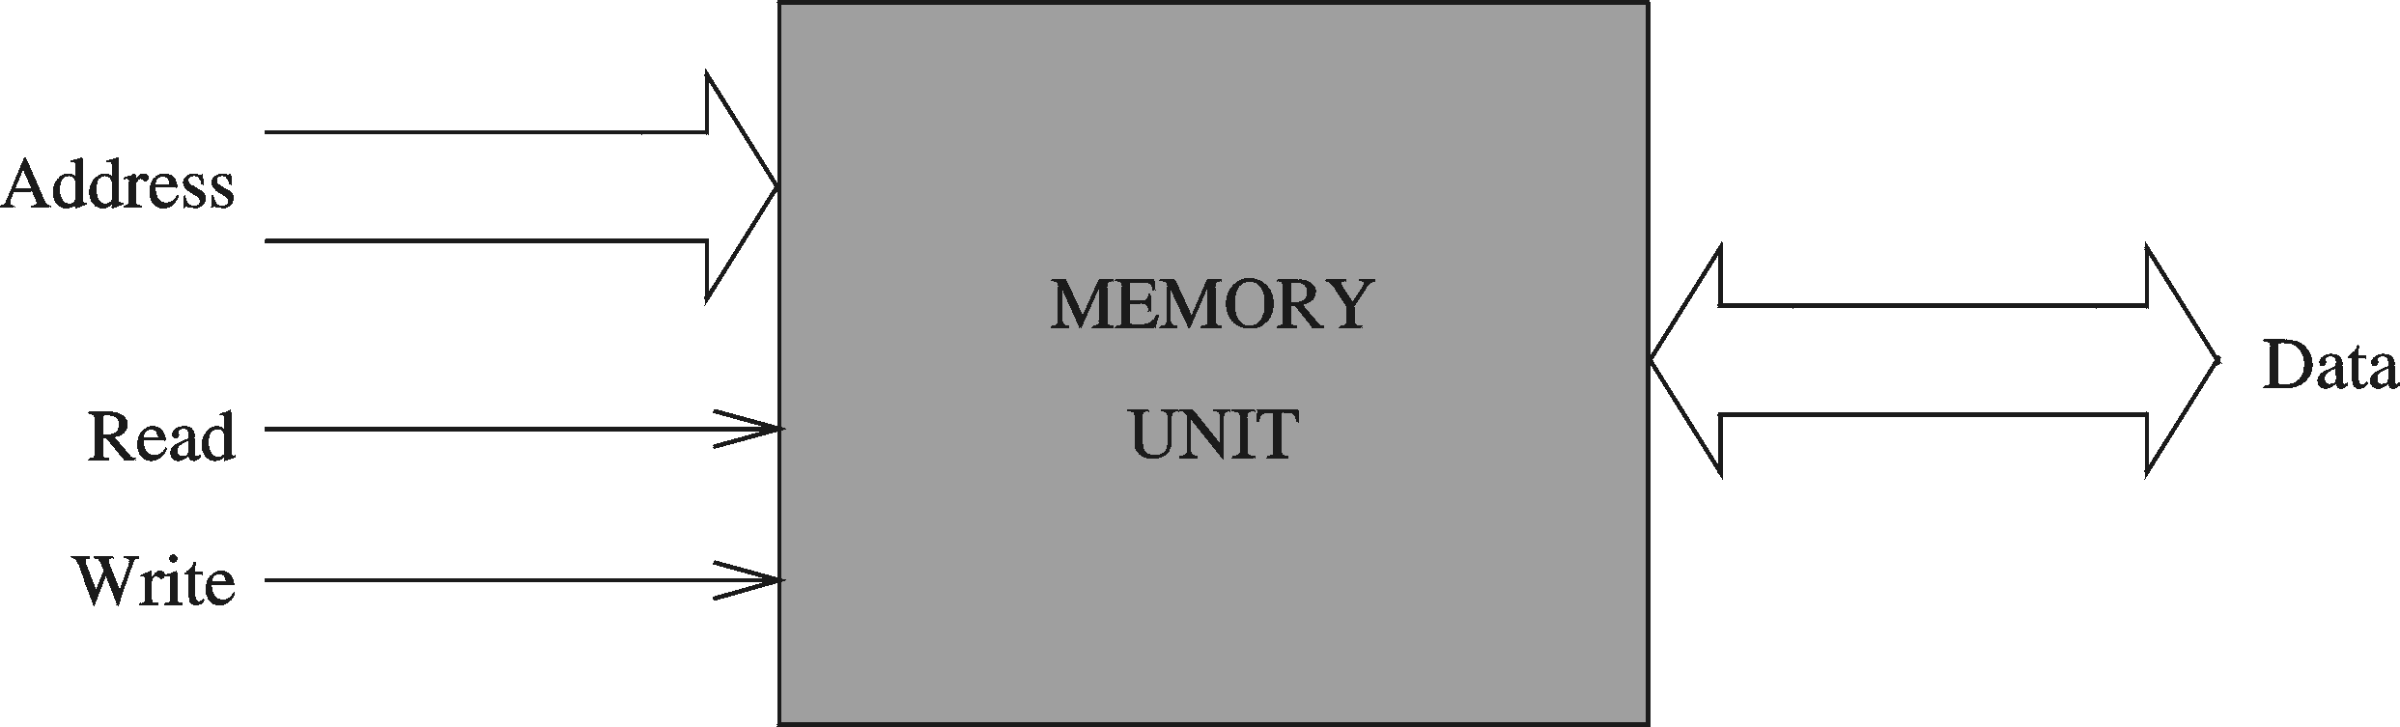
Memory Unit
Address Bus
Address is placed on the address bus
Address of location to be read/written
Data Bus
Data is placed on the data bus
Two Control Signals
Read
Write
Control whether memory should be read or written

Slide 14
Memory Read and Write Cycles
Read cycle
1. Processor places address on the address bus
2. Processor asserts the memory read control signal
3. Processor waits for memory to place the data on the data bus
4. Processor reads the data from the data bus
Processor drops the memory read signal
Write cycle
1. Processor places address on the address bus
Processor asserts the memory write control signal
Processor places the data on the data bus
Wait for memory to store the data (wait states for slow memory)
5. Processor drops the memory write signal

Slide 15
Reading from Memory
Multiple clock cycles are required
Memory responds much more slowly than the CPU
Address is placed on address bus
Read Line (RD) goes low, indicating that processor wants to read
CPU waits (one or more cycles) for memory to respond
Read Line (RD) goes high, indicating that data is on the data bus

Slide 16
Memory Devices
ROM = Read-Only Memory
Stores information permanently (non-volatile)
Used to store the information required to startup the computer
Many types: ROM, EPROM, EEPROM, and FLASH
FLASH memory can be erased electrically in blocks
RAM = Random Access Memory
Volatile memory: data is lost when device is powered off
Dynamic RAM (DRAM)
Inexpensive, used for main memory, must be refreshed constantly
Static RAM (SRAM)
Expensive, used for cache memory, faster access, no refresh
Video RAM (VRAM)
Dual ported: read port to refresh the display, write port for updates

Slide 17
Memory Hierarchy
Registers
Fastest storage elements, stores most frequently used data
General-purpose registers: accessible to the programmer
Special-purpose registers: used internally by the microprocessor
Cache Memory
Fast SRAM that stores recently used instructions and data
Recent processors have 2 levels
Main Memory (DRAM)
Disk Storage
Permanent magnetic
storage for files
registers
cache memory
higher speed, smaller size
lower cost per byte
main memory
disk storage

Slide 18
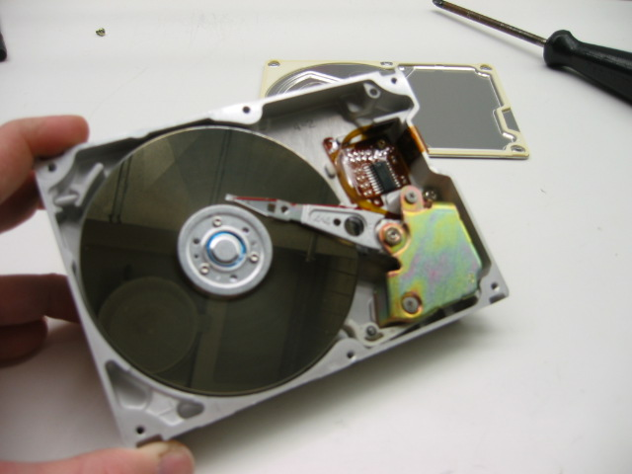
Magnetic Disk Storage
Disk Access Time =
Seek Time +
Rotation Latency +
Transfer Time
Sector
Read/write head
Actuator
Recording area
Seek Time: head movement to the desired track (milliseconds)
Rotation Latency: disk rotation until desired sector arrives under the head
Transfer Time: to transfer one sector
Track 2
Track 1
Track 0
Arm
Direction of rotation
Platter
Spindle

Slide 19
Example on Disk Access Time
Given a magnetic disk with the following properties
Rotation speed = 7200 RPM (rotations per minute)
Average seek = 8 ms, Sector = 512 bytes, Track = 200 sectors
Calculate
Time of one rotation (in milliseconds)
Average time to access a block of 32 consecutive sectors
Answer
Rotations per second
Rotation time in milliseconds
Average rotational latency
Time to transfer 32 sectors
Average access time
= 7200/60 = 120 RPS
= 1000/120 = 8.33 ms
= time of half rotation = 4.17 ms
= (32/200) * 8.33 = 1.33 ms
= 8 + 4.17 + 1.33 = 13.5 ms

Slide 20
Register Addressing
In this addressing mode, a register contains the operand. Depending upon the instruction, the register may be the first operand, the second operand or both.
MOV DX, TAX_RATE ; Register in first operand
MOV COUNT, CX ; Register in second operand
MOV EAX, EBX ; Both the operands are in registers
As processing data between registers does not involve memory, it provides fastest processing of data.

Slide 21
Immediate Addressing
An immediate operand has a constant value or an expression. When an instruction with two operands uses immediate addressing, the first operand may be a register or memory location, and the second operand is an immediate constant. The first operand defines the length of the data.
For example:
BYTE_VALUE DB 150 ; A byte value is defined
WORD_VALUE DW 300 ; A word value is defined
ADD BYTE_VALUE, 65 ; An immediate operand 65 is added
MOV AX, 45H ; Immediate constant 45H is transferred to AX

Slide 22
Direct Memory Addressing
When operands are specified in memory addressing mode, direct access to main memory, usually to the data segment, is required.
This way of addressing results in slower processing of data. To locate the exact location of data in memory, we need the segment start address, which is typically found in the DS register and an offset value.
This offset value is also called effective address.

Slide 23
Direct Memory Addressing
In direct addressing mode, the offset value is specified directly as part of the instruction, usually indicated by the variable name.
The assembler calculates the offset value and maintains a symbol table, which stores the offset values of all the variables used in the program.

Slide 24
Direct-Offset Addressing
This addressing mode uses the arithmetic operators to modify an address. For example, look at the following definitions that define tables of data:
BYTE_TABLE DB 14, 15, 22, 45 ; Tables of bytes
WORD_TABLE DW 134, 345, 564, 123 ; Tables of words

Slide 25
Direct Memory Addressing
In direct memory addressing, one of the operands refers to a memory location and the other operand references a register.
For example:
ADD BYTE_VALUE, DL ; Adds the register in the memory location
MOV BX, WORD_VALUE ; Operand from the memory is added to register

Slide 26
Direct Memory Addressing
The following operations access data from the tables in the memory into registers:
MOV CL, BYTE_TABLE[2] ; Gets the 3rd element of the BYTE_TABLE MOV CL, BYTE_TABLE + 2 ; Gets the 3rd element of the BYTE_TABLE MOV CX, WORD_TABLE[3] ; Gets the 4th element of the
WORD_TABLE MOV CX, WORD_TABLE + 3 ; Gets the 4th element of the WORD_TABLE

Slide 27
Indirect Memory Addressing
This addressing mode utilizes the computer's ability of Segment:Offset addressing. Generally the base registers EBX, EBP (or BX, BP) and the index registers (DI, SI), coded within square brackets for memory references, are used for this purpose.
Indirect addressing is generally used for variables containing several elements like, arrays. Starting address of the array is stored in, say, the EBX register

Slide 28
Indirect Memory Addressing
The following code snippet shows how to access different elements of the variable.
MY_TABLE TIMES 10 DW 0 ; Allocates 10 words (2 bytes) each initialized to 0 MOV EBX, [MY_TABLE] ; Effective Address of MY_TABLE in EBX
MOV [EBX], 110 ; MY_TABLE[0] = 110
ADD EBX, 2 ; EBX = EBX +2
MOV [EBX], 123 ; MY_TABLE[1] = 123

Slide 29
The MOV Instruction
We have already used the MOV instruction that is used for moving data from one storage space to another. The MOV instruction takes two operands.
SYNTAX:
Syntax of the MOV instruction is:
MOV destination, source

Slide 30
The MOV Instruction
The MOV instruction may have one of the following five forms:
MOV register, register
MOV register, immediate
MOV memory, immediate
MOV register, memory
MOV memory, register

Slide 31
Please note that:
Both the operands in MOV operation should be of same size
The value of source operand remains unchanged
The MOV instruction causes ambiguity at times. For example, look at the statements.
MOV EBX, [MY_TABLE] ; Effective Address of MY_TABLE in EBX
MOV [EBX], 110 ; MY_TABLE[0] = 110

Slide 32
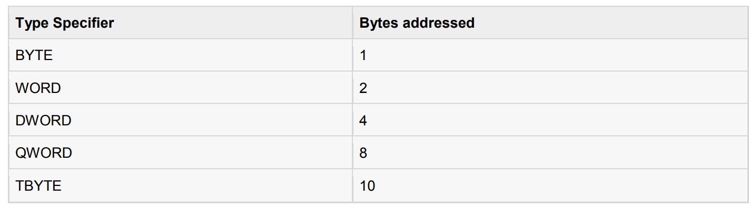
It is not clear whether you want to move a byte equivalent or word equivalent of the number 110. In such cases, it is wise to use a type specifier.
Following table shows some of the common type specifiers:

Slide 33
EXAMPLE:
The following program illustrates some of the concepts discussed above. It stores a name 'Zara Ali' in the data section of the memory. Then changes its value to another name 'Nuha Ali' programmatically and displays both the names.

Slide 34
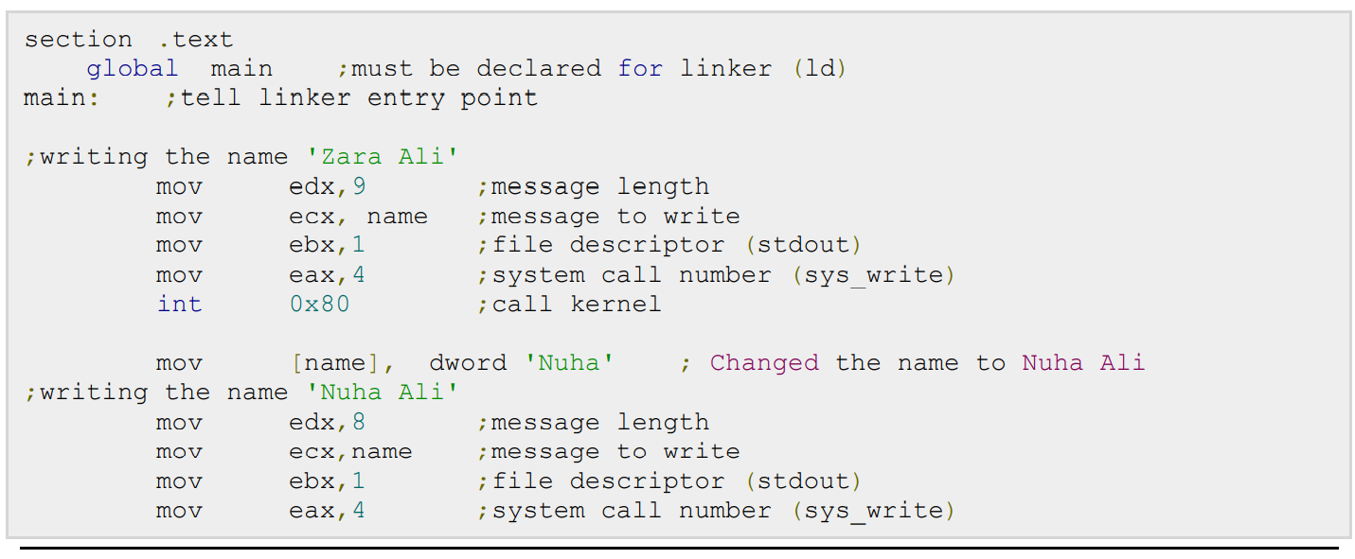

Slide 35
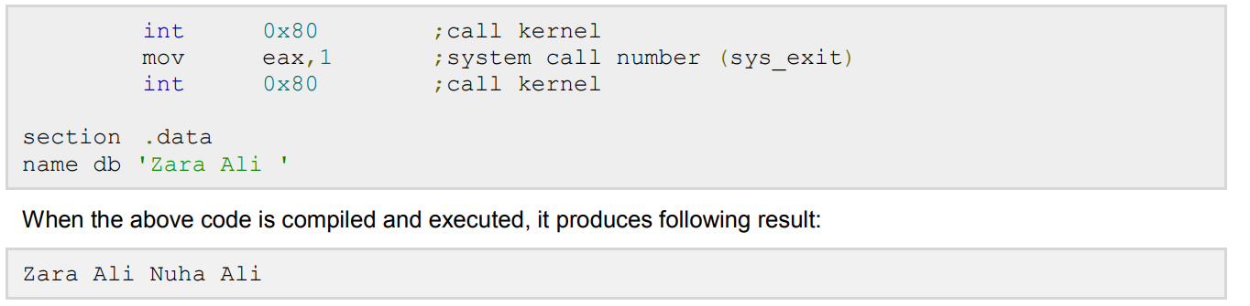

Slide 36
ASSEMBLY VARIABLES

Slide 37
Assembly Variables
NASM provides various define directives for reserving storage space for variables. The define assembler directive is used for allocation of storage space. It can be used to reserve as well as initialize one or more bytes.

Slide 38
Allocating Storage Space for Initialized Data
The syntax for storage allocation statement for initialized data is:
[variable-name] define-directive initial-value [,initial-value]...
Where, variable-name is the identifier for each storage space. The assembler associates an offset value for each variable name defined in the data segment.

Slide 39
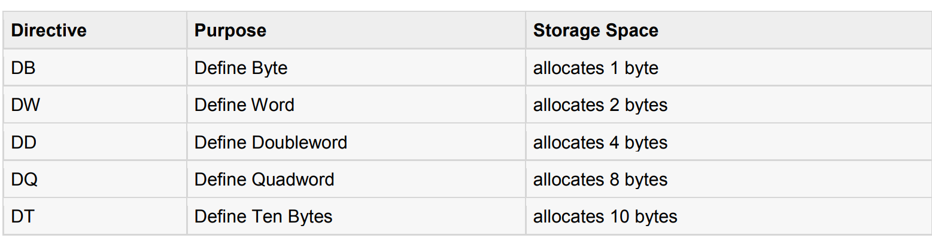
Allocating Storage Space for Initialized Data
There are five basic forms of the define directive:

Slide 40
Allocating Storage Space for Initialized Data
Following are some examples of using define directives:
choice DB 'y’
Number DW 12345
neg_number DW -12345
big_number DQ 123456789
real_number1 DD 1.234
real_number2 DQ 123.456

Slide 41
Allocating Storage Space for Initialized Data
Please note that:
Each byte of character is stored as its ASCII value in hexadecimal
Each decimal value is automatically converted to its 16-bit binary equivalent and stored as a hexadecimal number
Processor uses the little-endian byte ordering
Negative numbers are converted to its 2's complement representation
Short and long floating-point numbers are represented using 32 or 64 bits, respectively

Slide 42
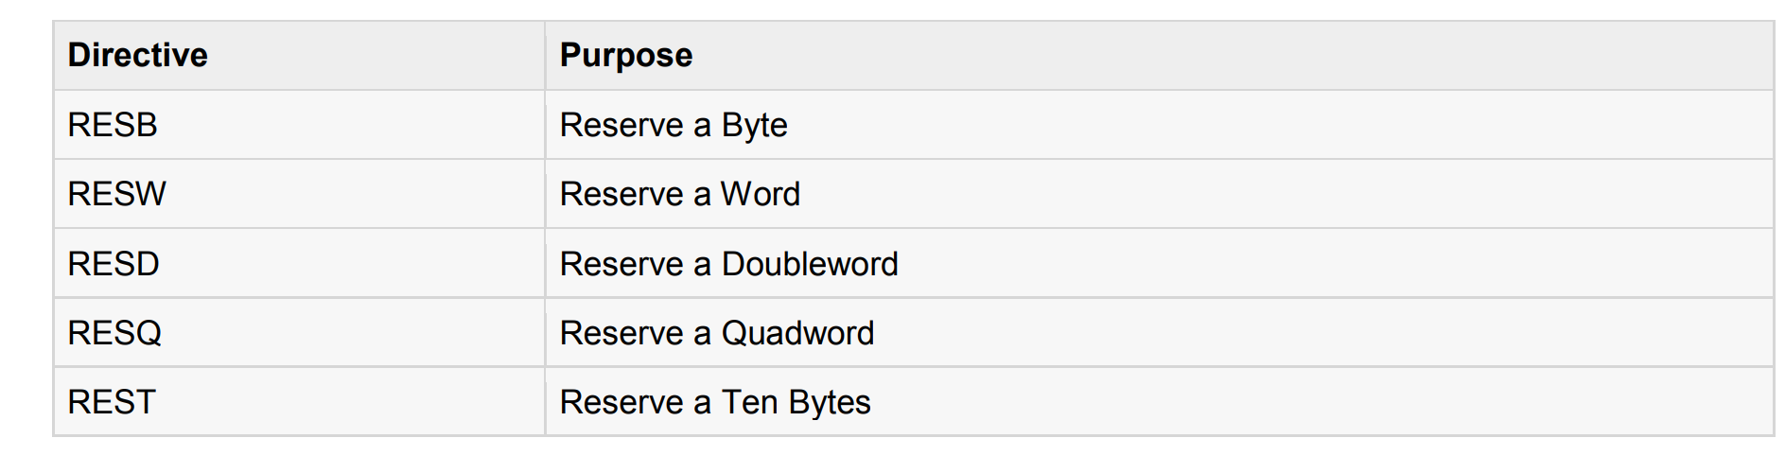
Allocating Storage Space for Uninitialized Data
The reserve directives are used for reserving space for uninitialized data. The reserve directives take a single operand that specifies the number of units of space to be reserved. Each define directive has a related reserve directive.
There are five basic forms of the reserve directive:

Slide 43
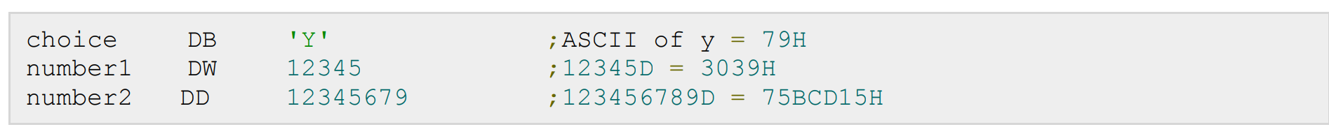
Multiple Definitions
You can have multiple data definition statements in a program. For example:

Slide 44
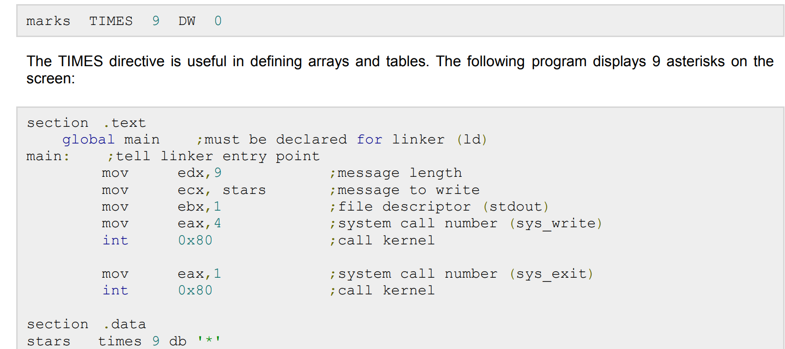
Multiple Initializations
The TIMES directive allows multiple initializations to the same value. For example, an array named marks of size 9 can be defined and initialized to zero using the following statement:

Slide 45
ASSEMBLY CONSTANTS

Slide 46
Assembly Variables
There are several directives provided by NASM that define constants. We have already used the EQU directive in previous chapters. We will particularly discuss three directives:
EQU
%assign
%define

Slide 47
The EQU Directive
The EQU directive is used for defining constants. The syntax of the EQU directive is as follows:
CONSTANT_NAME EQU expression
For example,
TOTAL_STUDENTS equ 50
You can then use this constant value in your code, like:
mov ecx, TOTAL_STUDENTS
cmp eax, TOTAL_STUDENTS

Slide 48
The EQU Directive
The operand of an EQU statement can be an expression:
LENGTH equ 20
WIDTH equ 10
AREA equ length * width
Above code segment would define AREA as 200

Slide 49
The EQU Directive
Example:
The following example illustrates the use of the EQU directive:
SYS_EXIT equ 1
SYS_WRITE equ 4

Slide 50
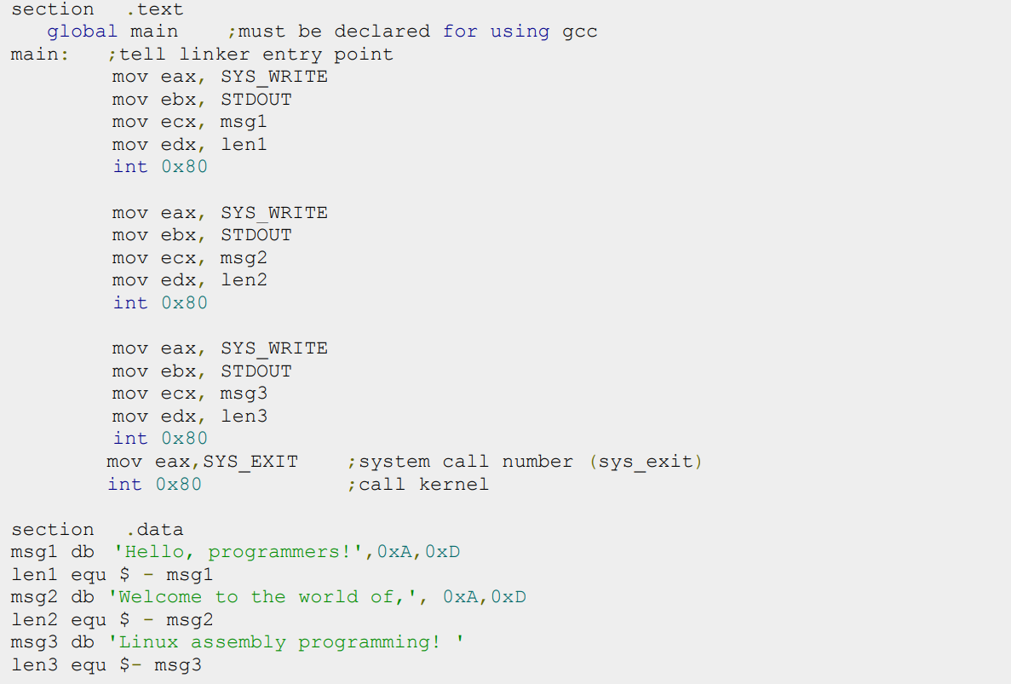

Slide 51
When the above code is compiled and executed, it produces following result:
Hello, programmers!
Welcome to the world of,
Linux assembly programming!

Slide 52
The %assign Directive
The %assign directive can be used to define numeric constants like the EQU directive. This directive allows redefinition. For example, you may define the constant TOTAL as:
%assign TOTAL 10
Later in the code you can redefine it as:
%assign TOTAL 20
This directive is case-sensitive.

Slide 53
The %define Directive
The %define directive allows defining both numeric and string constants. This directive is similar to the #define in C. For example, you may define the constant PTR as:
%define PTR [EBP+4]
The above code replaces PTR by [EBP+4]. This directive also allows redefinition and it is case sensitive

Slide 54
Arithmetic Instructions

Slide 55
Arithmetic Instructions
The INC instruction is used for incrementing an operand by one. It works on a single operand that can be either in a register or in memory.
SYNTAX:
The INC instruction has the following syntax:
INC destination
The operand destination could be an 8-bit, 16-bit or 32-bit operand.

Slide 56
Arithmetic Instructions
EXAMPLE:
INC EBX ; Increments 32-bit register
INC DL ; Increments 8-bit register
INC [count] ; Increments the count variable

Slide 57
The DEC Instruction
The DEC instruction is used for decrementing an operand by one. It works on a single operand that can be either in a register or in memory.
SYNTAX:
The DEC instruction has the following syntax:
DEC destination
The operand destination could be an 8-bit, 16-bit or 32-bit operand.

Slide 58
The DEC Instruction
EXAMPLE:
segment .data
count dw 0
value db 15
segment .text
inc [count]

Slide 59
The DEC Instruction
dec [value]
mov ebx, count
inc word [ebx]
mov esi, value
dec byte [esi]

Slide 60
The ADD and SUB Instructions
The ADD and SUB instructions are used for performing simple addition/subtraction of binary data in byte, word and doubleword size, i.e., for adding or subtracting 8-bit, 16-bit or 32-bit operands respectively.
SYNTAX:
The ADD and SUB instructions have the following syntax
ADD/SUB destination, source

Slide 61
The ADD/SUB instruction can take place between:
Register to register
Memory to register
Register to memory
Register to constant data
Memory to constant data
However, like other instructions, memory-to-memory operations are not possible using ADD/SUB instructions. An ADD or SUB operation sets or clears the overflow and carry flags.

Slide 62
EXAMPLE:
The following example asks two digits from the user, stores the digits in the EAX and EBX register respectively, adds the values, stores the result in a memory location 'res' and finally displays the result.

Slide 63
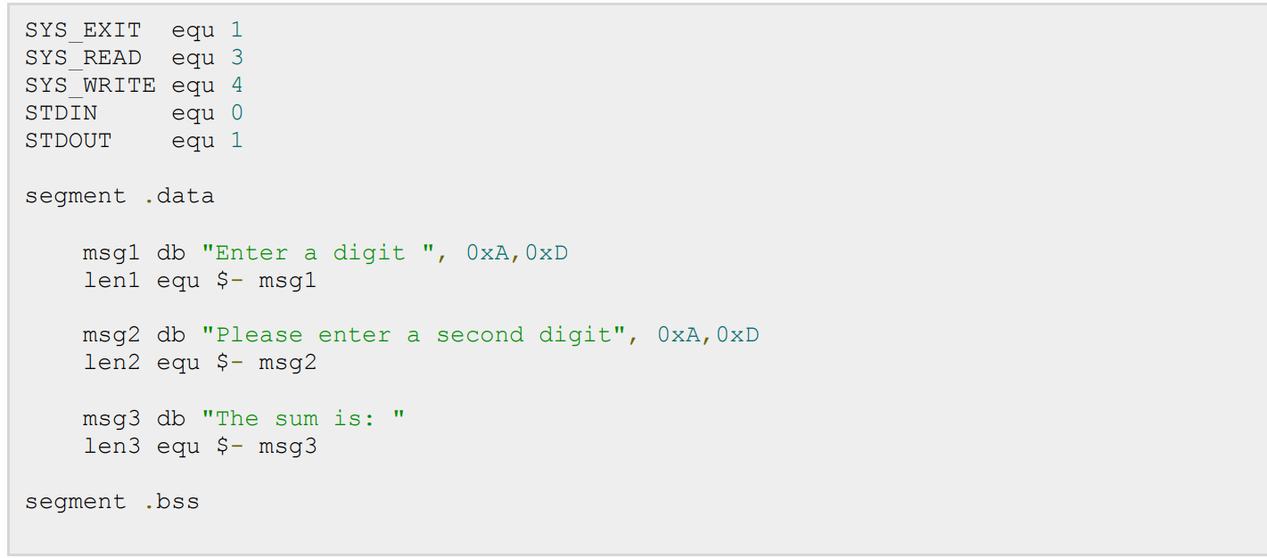

Slide 64
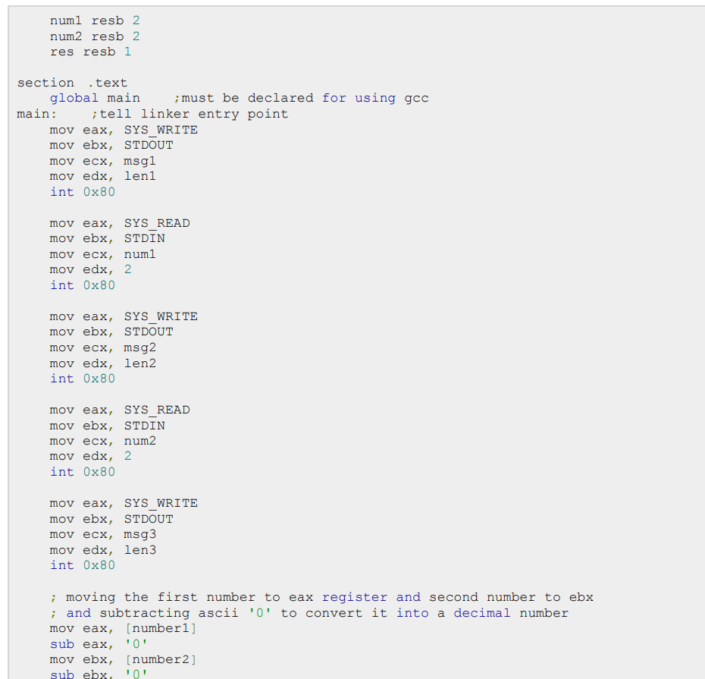

Slide 65
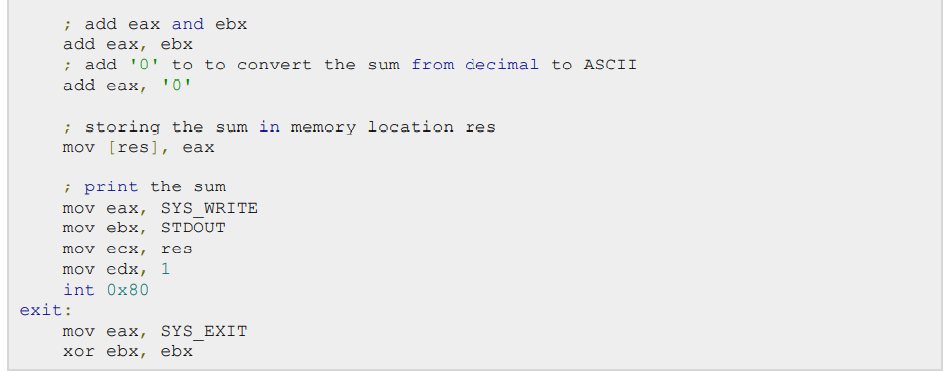

Slide 66
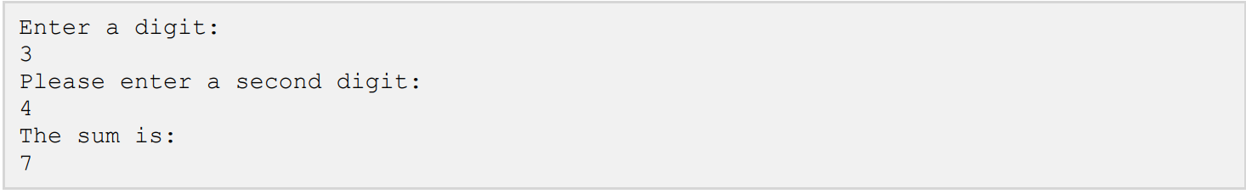
When the above code is compiled and executed, it produces following result:

Slide 67
The MUL/IMUL Instruction
There are two instructions for multiplying binary data. The MUL (Multiply) instruction handles unsigned data and the IMUL (Integer Multiply) handles signed data. Both instructions affect the Carry and Overflow flag.

Slide 68
SYNTAX:
The syntax for the MUL/IMUL instructions is as follows:
MUL/IMUL multiplier
Multiplicand in both cases will be in an accumulator, depending upon the size of the multiplicand and the multiplier and the generated product is also stored in two registers depending upon the size of the operands. Following section explains MULL instructions with three different cases:

Slide 69
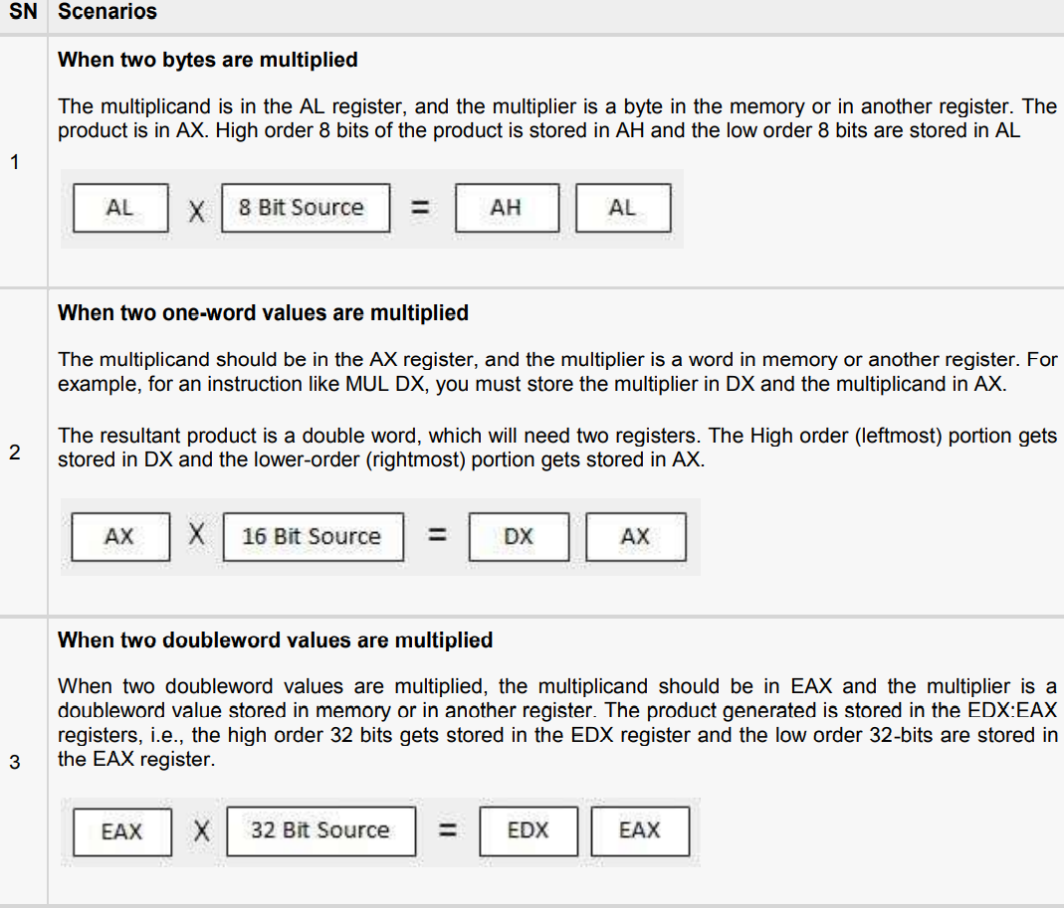

Slide 70
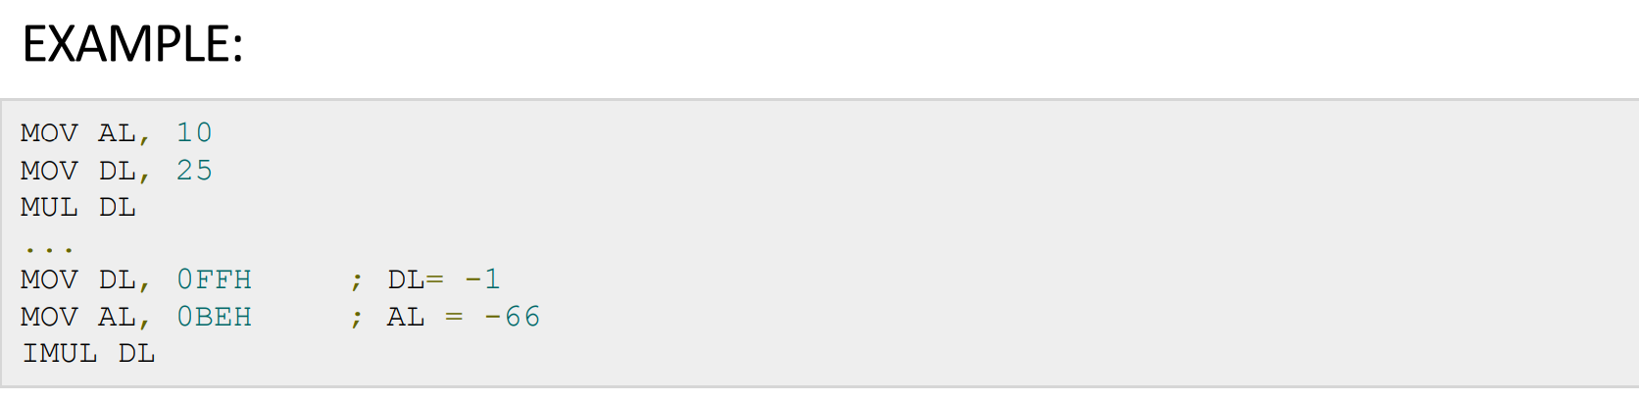
EXAMPLE:

Slide 71
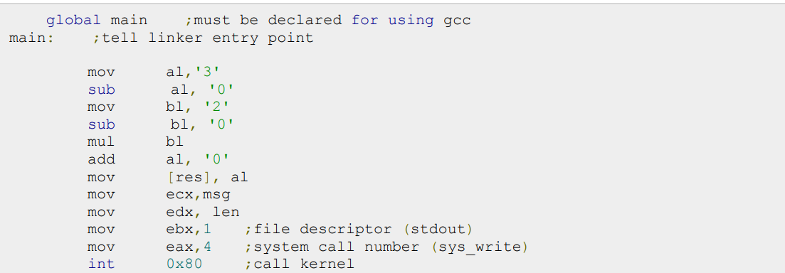
EXAMPLE:
The following example multiplies 3 with 2, and displays the result:

Slide 72
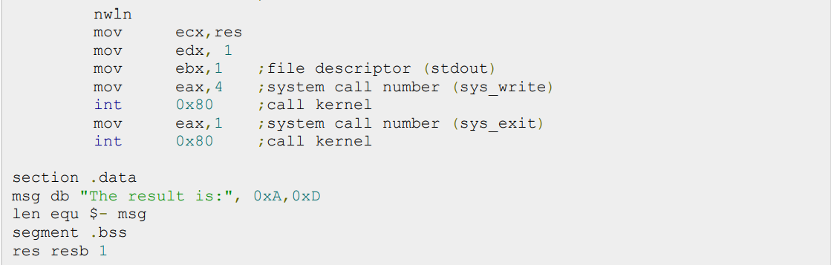

Slide 73
When the above code is compiled and executed, it produces following result:

Slide 74
The DIV/IDIV Instructions
The division operation generates two elements - a quotient and a remainder.
In case of multiplication, overflow does not occur because double-length registers are used to keep the product.
However, in case of division, overflow may occur. The processor generates an interrupt if overflow occurs.
The DIV (Divide) instruction is used or unsigned data and the IDIV (Integer Divide) is used for signed data

Slide 75
SYNTAX:
The format for the DIV/IDIV instruction:
DIV/IDIV divisor
The dividend is in an accumulator. Both the instructions can work with 8-bit, 16-bit or 32-bit operands. The operation affects all six status flags. Following section explains three cases of division with different operand size:

Slide 76
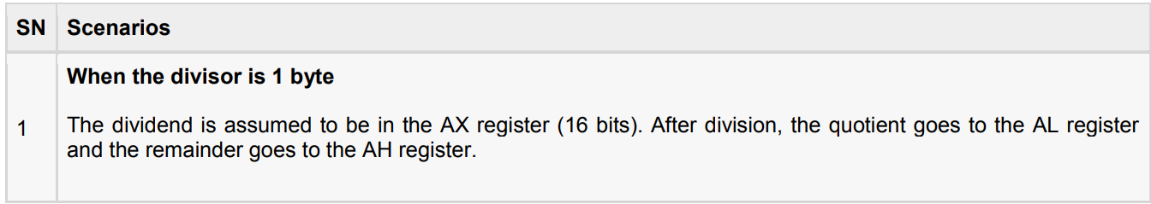

Slide 77
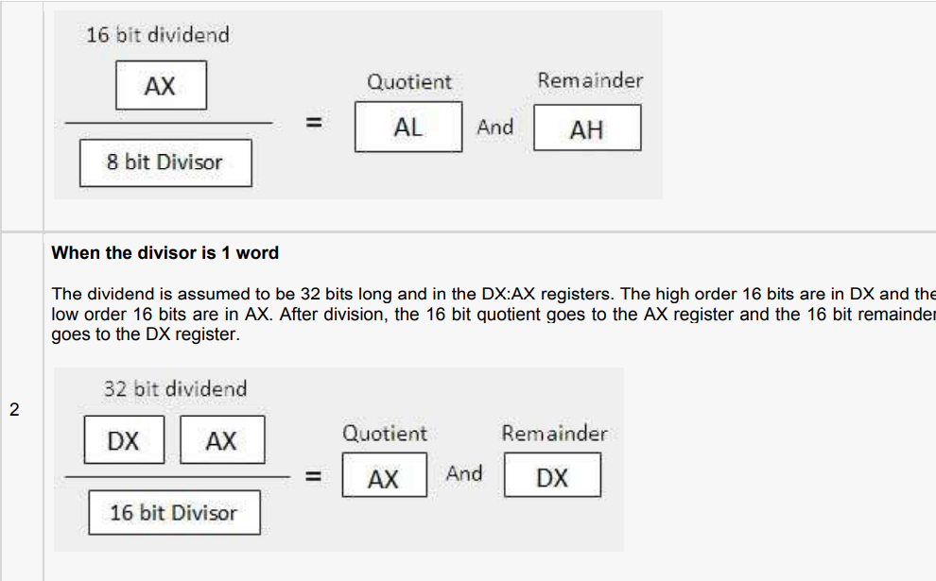

Slide 78
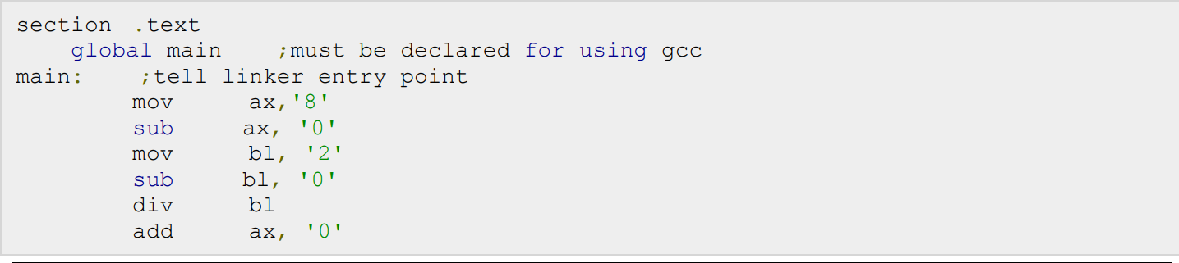
EXAMPLE:
The following example divides 8 with 2. The dividend 8 is stored in the 16 bit AX register and thedivisor 2 is stored in the 8 bit BL register.

Slide 79
